Slide 1






Edrak
"An autism-friendly educational journey awaits in our game."

Slide 2
Introduction & Purpose
Edrak is an educational game that is specially tailored for children with autism. We strive to offer an educational game that supports the Arabic language, addresses their sensory needs, and provides educational value.

Slide 3

Completed Tasks and Achievements
User Interface | We carefully designed the UI to match sensory needs. Ex. Adopting Vertical alignment and using favored colors.
Simple Levels | Accommodating different levels of perception for every child. Ex. 4 different levels with different difficulties.
Rewarding System | We integrated game logic that grants a rewarding system. Ex. Confetti, Score, etc.
Multi-dimensional Learning | Focused improving social, cognitive, and emotional skills. Ex. A counting game with multiple levels.

Slide 4

Challenges Faced
Absorbing New Material
Database Implementation
Navigating Time Constraints
Balancing time constraints with other courses was a major challenge in this project.
The pressure to absorb new material in such a short period of time was challenging.
We acknowledged the difficulties and complexity with database implementation.

Slide 5
Lessons Learned
01
02
03
Improved time management skills
Handling pressure effectively
Gaining knowledge in database
We effectively overcome this challenge by working as a team and dividing work successfully.
We were encouraged to become fast learners.
Our work with databases remains a work in progress but, gaining knowledge in its complexity makes us more committed coming forward.

Slide 6
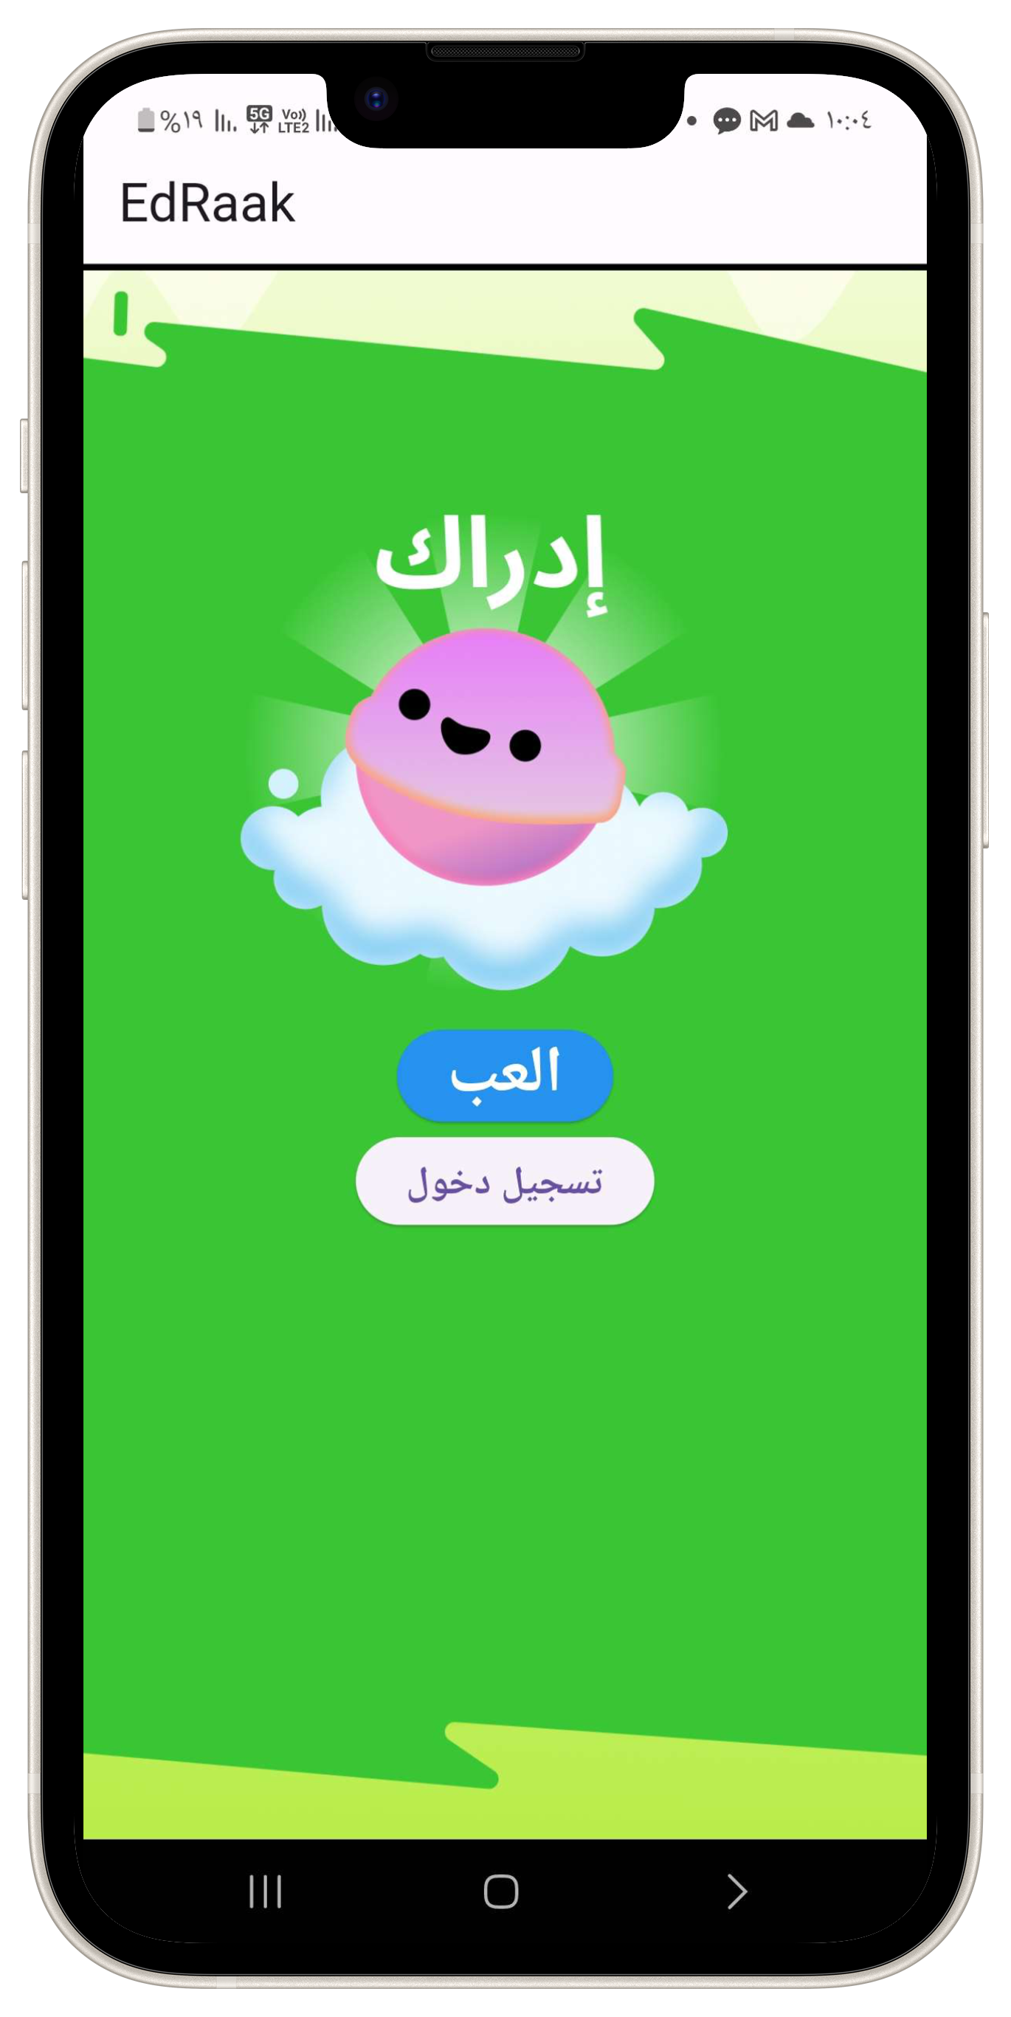
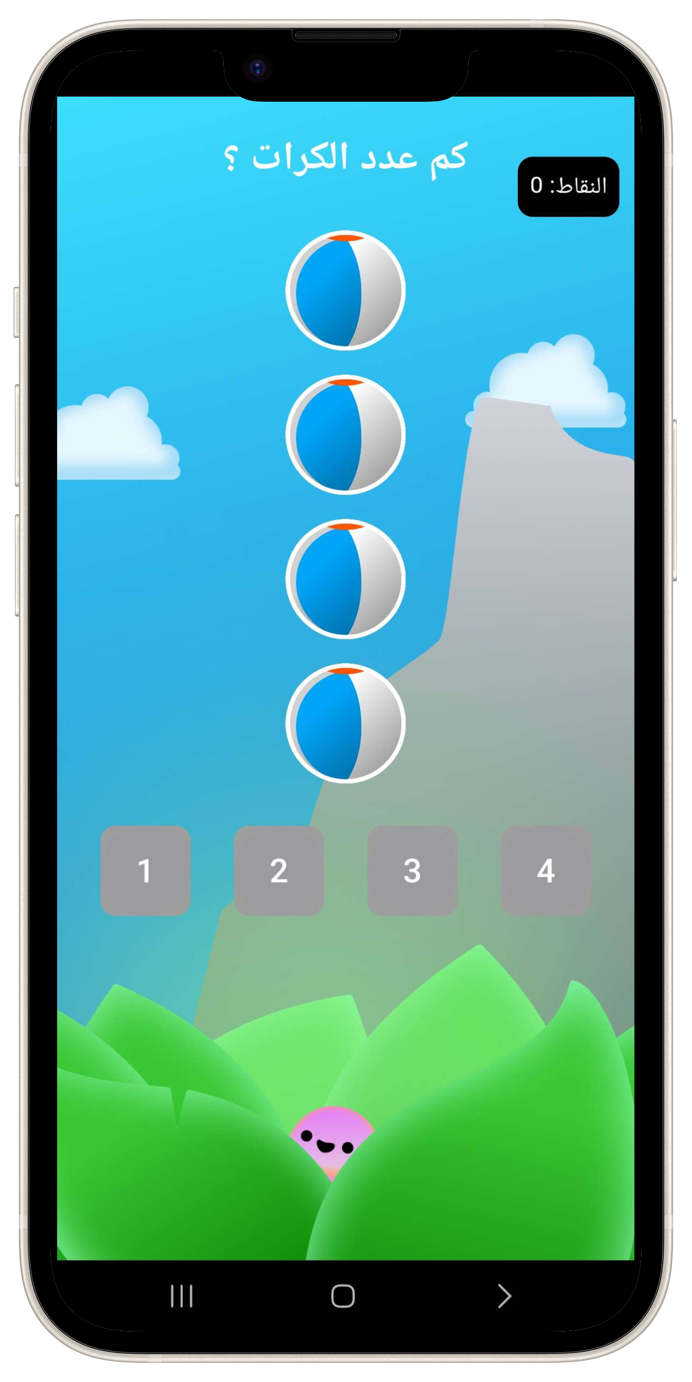
Edrak Game Architecture
01
02
Main Menu
First Level
70%
2024
30%
2025

Slide 7
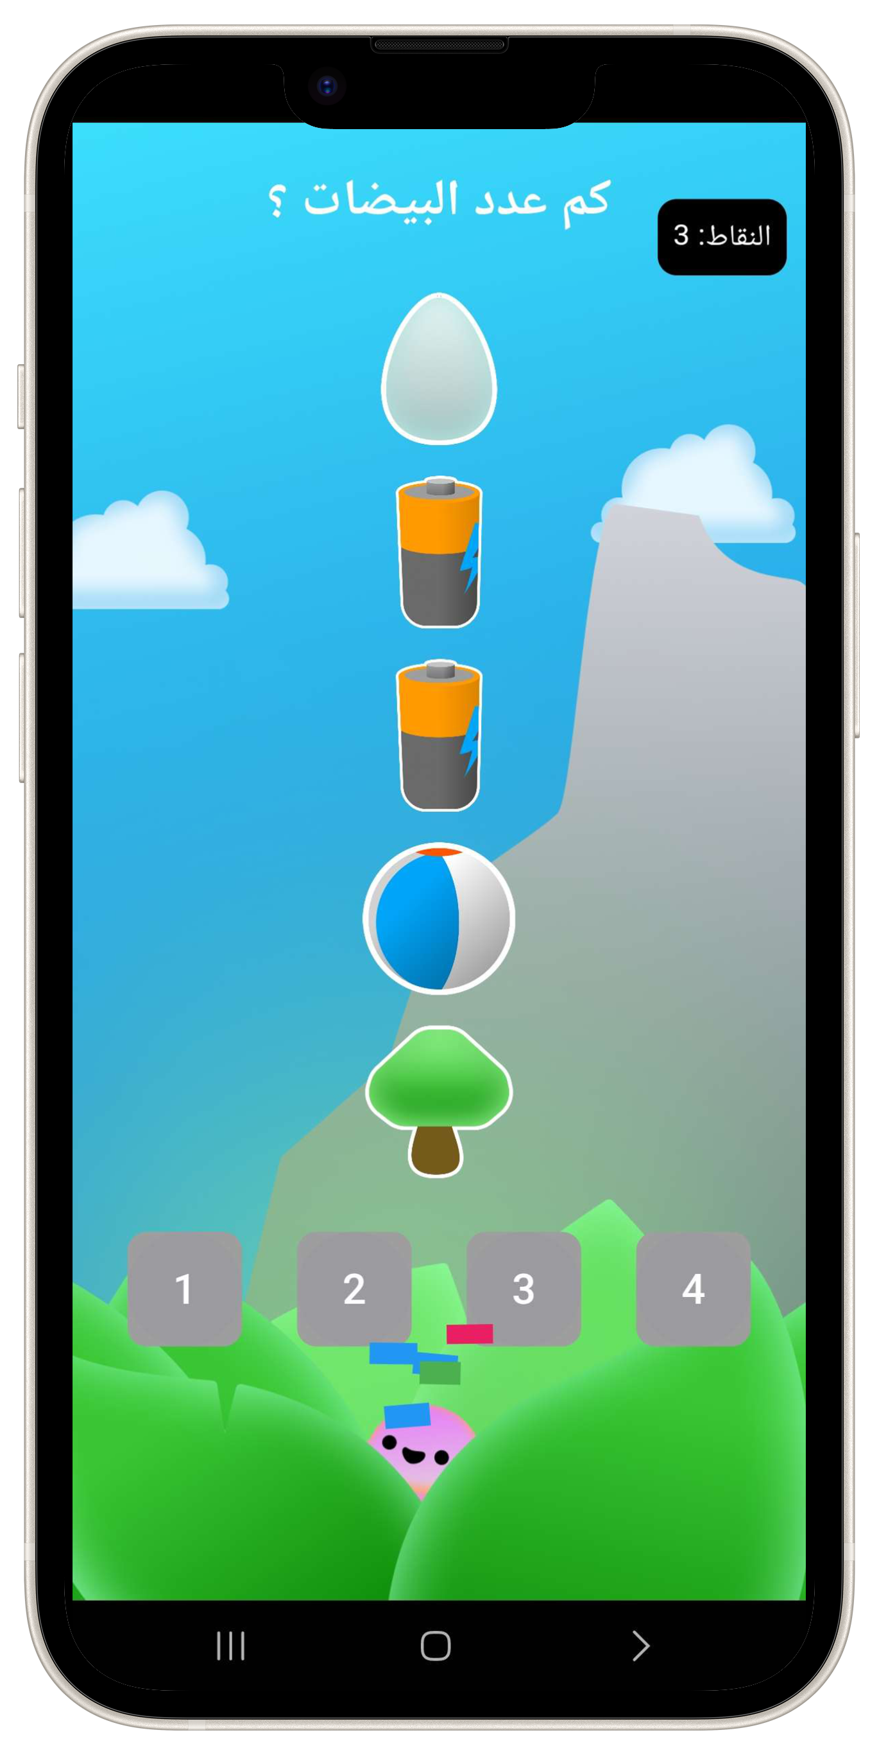
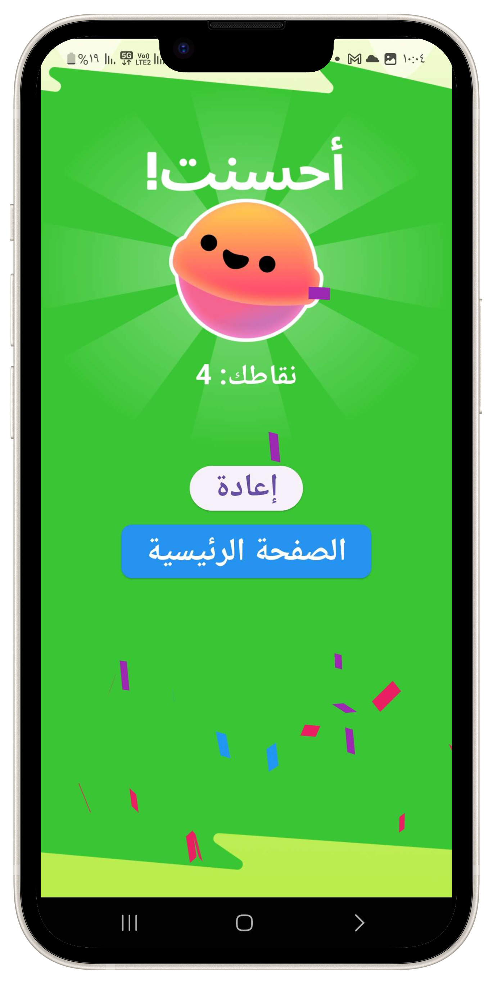
Edrak Game Architecture
03
04
Final Level
Result Page
2024
70%
30%
2025

Slide 8
Our Upcoming Plans & SWE2
01
02
03
Creating a database
More Games & Levels
Better UI/UX
Upcoming we will create a database to store the user’s account information and progress.
We have a plan to add extra games, making the game a game catalog focused on education.
The UI should be simple and uncluttered to avoid overwhelming the user. Colors, shapes, and animations need to be used thoughtfully.
The UX should be structured to provide a sense of routine and predictability, which can help create a comforting environment for children with autism.

Slide 9

Thanks!
Any questions?

